Slide 1
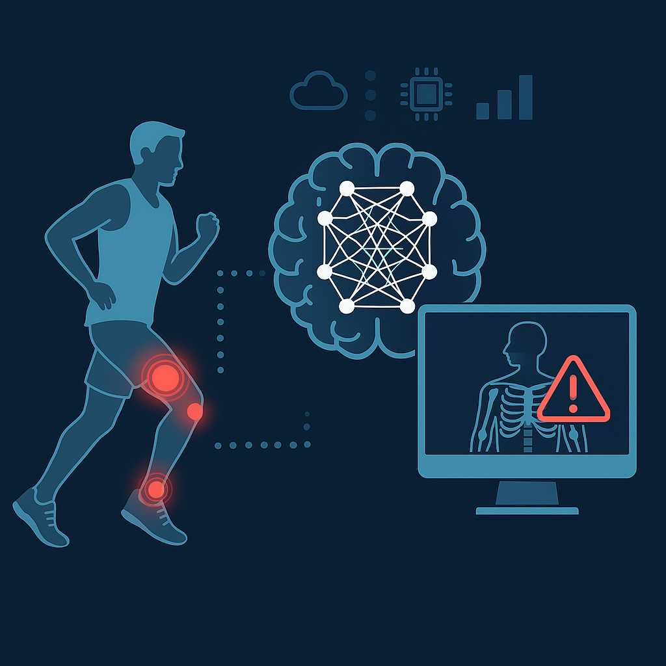

GUARDING THE GAME: DEEP NEURAL NETWORKS IN ATHLETE INJURY PREDICTION
BY
AJITH RAJ PERIYASAMY

Slide 2
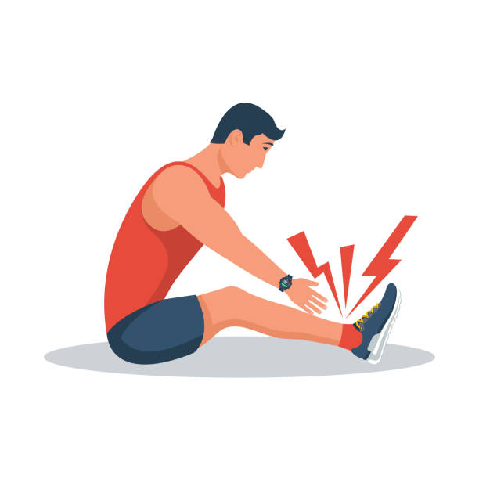
INTRODUCTION
Athlete injuries impact performance, careers, and team outcomes
Traditional prevention methods are reactive, not personalized
Deep Neural Networks (DNNs) predict injuries early by detecting hidden patterns

Slide 3
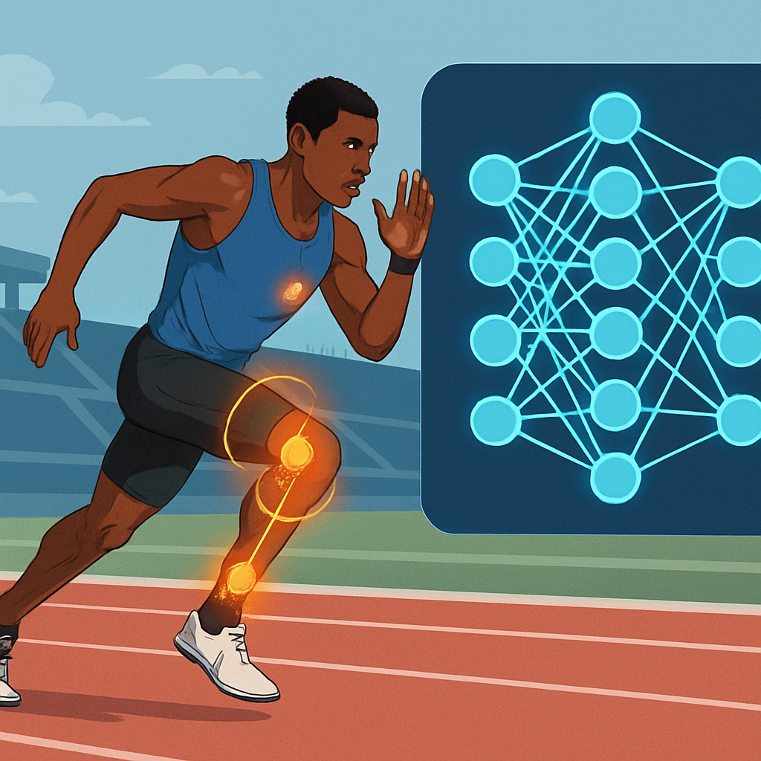
DL TECHNIQUES USED
CNN – to analyze spatial data
RNNs & LSTM – Model time-series sequences
Advanced models – Autoencoders, CNN-LSTM hybrids, Residential Attention U-Nets.

Slide 4
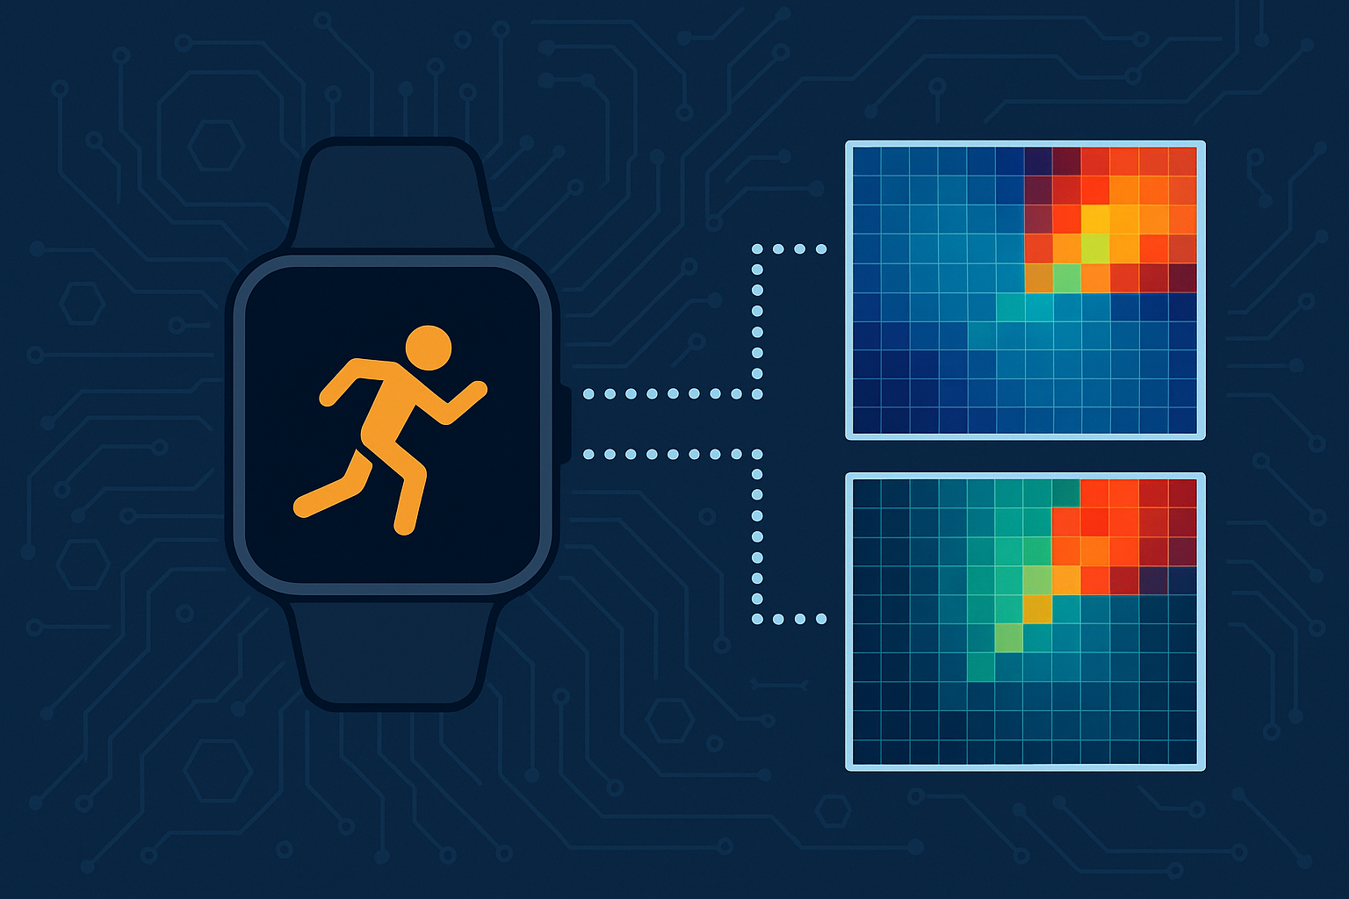
APPLICATIONS - WEARABLES
Transform motion sensor data into images for analysis
Example: GASF, GADF encoding
Semi-supervised clustering improved prediction
Challenges: Small datasets, data imbalance, real-time feasibility

Slide 5
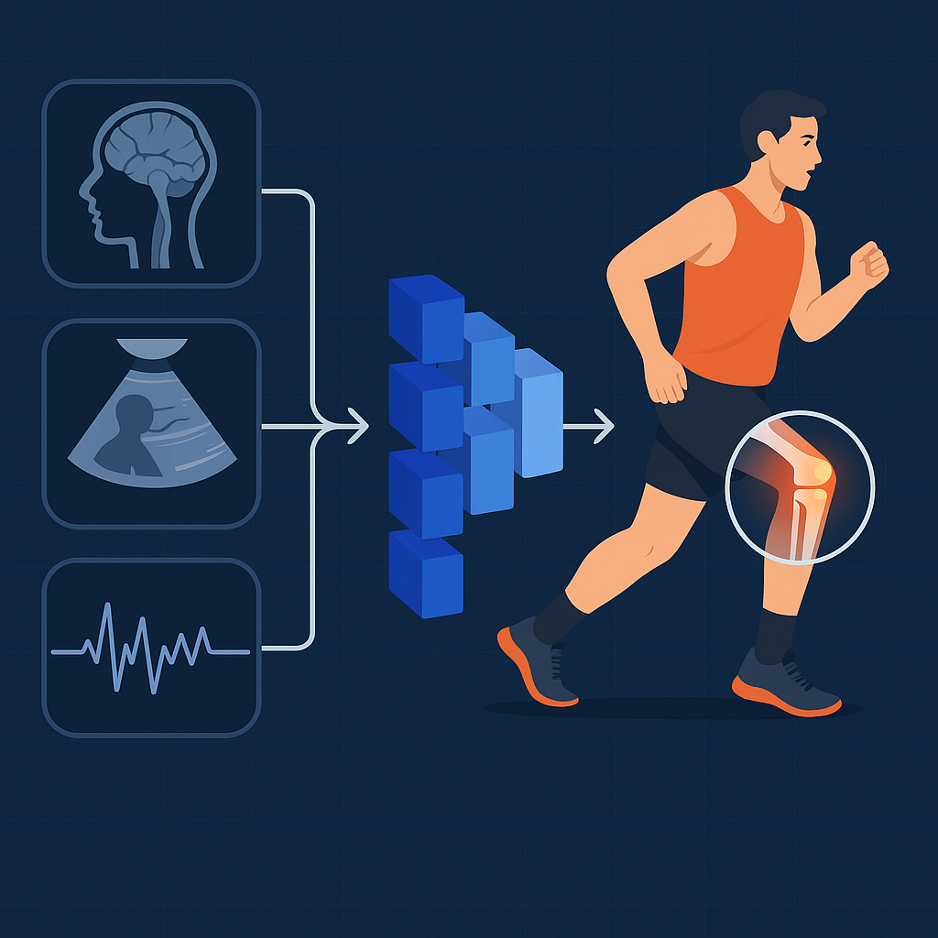
APPLICATIONS – MEDICAL IMAGING
Analyze MRI, EMG, and ultrasound images with CNNs
CNN-LSTM hybrid detects ACL injuries with 95.6% accuracy
RAU-Net segments injuries in MRI scans
Challenges: Dataset size, high computational needs, explainability

Slide 6
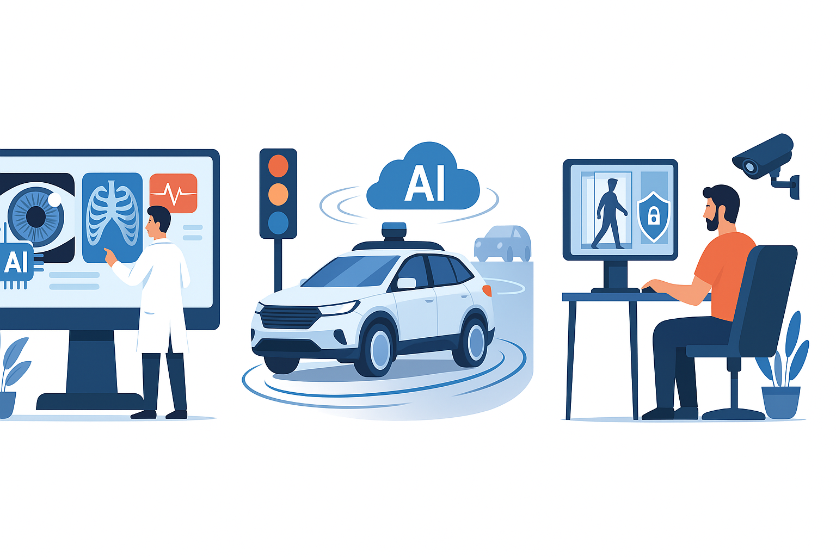
INDUSTRY APPLICATIONS OF DEEP NETWORKS
Healthcare: Disease detection (DeepMind eye AI, COVID-Net).
Transportation: Autonomous vehicles (Waymo, NVIDIA), traffic optimization.
Security: Surveillance (Qatar airport), cybersecurity threat detection.

Slide 7
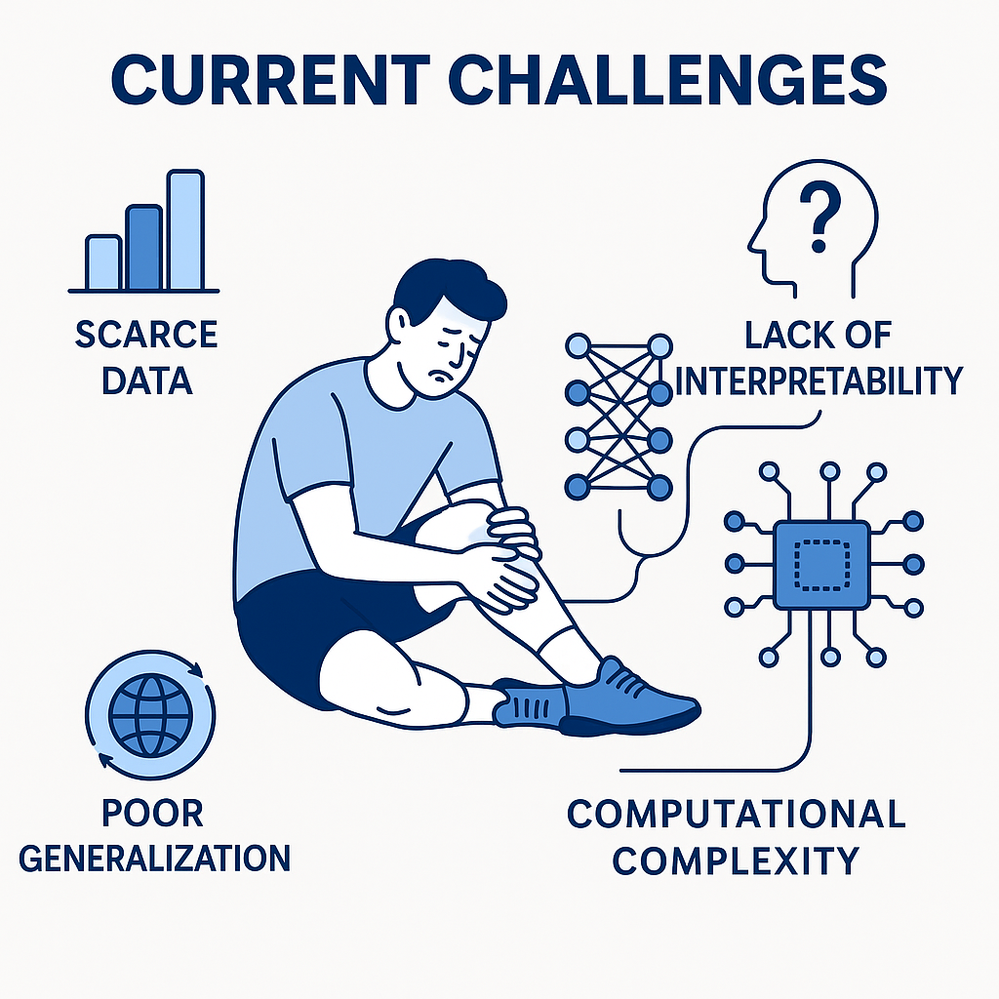
CHALLENGES
Scarce and imbalanced injury datasets
Poor generalization across sports, sensors, and teams
Lack of model interpretability (black-box problem)
Computational complexity for real-time use

Slide 8
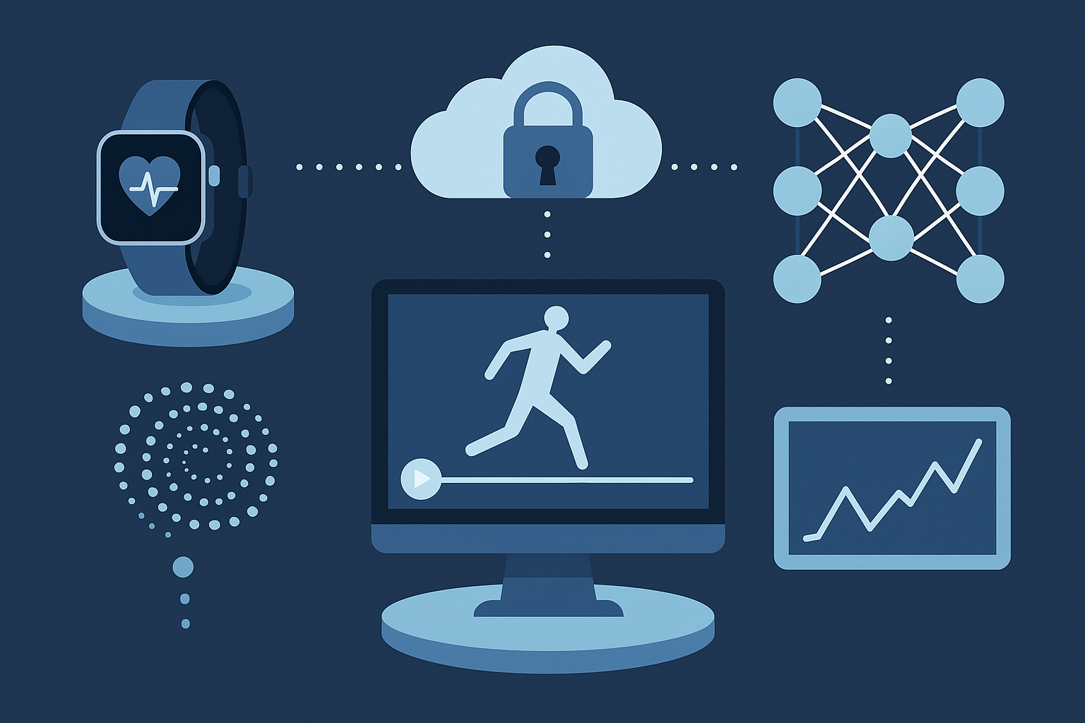
FUTURE DIRECTIONS
Multimodal models combining motion, physiological, video data
Temporal modeling: LSTM, Transformer architectures
Explainable AI (e.g., SHAP, LRP) to build user trust
Edge AI for wearable real-time monitoring
Federated learning to preserve athlete data privacy

Slide 9
